Slide 1
CAR PRICE PREDICTION PROJECT
By:
Kamran Ashraf

Slide 2
Table of contents
1. Introduction
2. Data Visualization
3. Interpretation of Results
4. Conclusion

Slide 3
INTRODUCTION

Slide 4
Business Problem Framing
With the Covid-19 impact in the market, we have seen lot of changes in the car market. Now some cars are in demand hence making them costly and some are not in demand hence cheaper. One of our clients works with small traders, who sell used cars. With the change in market due to Covid-19 impact, our client is facing problems with their previous car price valuation machine learning models. So, they are looking for new machine learning models from new data. We have to make car price valuation model.
Review of Literature
The aim of this project is to build a model which can be used to predict the car price. This project is more about data exploration, finding the better insights from data and using the skills and techniques to build an efficient model which can predict the prices after the recession faced during Covid-19 crisis. Since we scrape a good amount of data that are related to the price of car, we can do better data exploration and derive some interesting features using the available columns.

Slide 5
Analytical Problem Framing
Mathematical/ Analytical Modelling of the Problem
In this project we have worked to predict the price of the used car. ‘Price’ is our target column and it is continuous in nature, so we’re dealing with regression type of problem.
This project is based on 2 main phases-
Data Collection: In this section, we need to scrape the data of used cars from websites (Olx, car Dekho, Cars24 etc.). Web scraping is required for this. We have to fetch data for different locations. Generally, the features columns are Brand, model, variant, manufacturing year, driven kilometres, fuel, number of owners, location and at last target variable Price of the car. This data is to give a hint about important variables in used car model. We can make changes to it, we can add or you can remove some columns, it completely depends on the website from which we are fetching the data. We have tried to include all types of cars in our data for example- SUV, Sedans, Coupe, minivan, Hatchback.
Model Building: After collecting the data, you need to build a machine learning model. Before model building do all data pre-processing steps. Try different models with different hyper parameters and select the best model.

Slide 6
Problem Solving Approaches
We follow the below mentioned approach to get the best predictive model:
Data preparation
Data cleaning
Data analysis
Conclusion

Slide 7
DATA VISUALIZATION

Slide 8
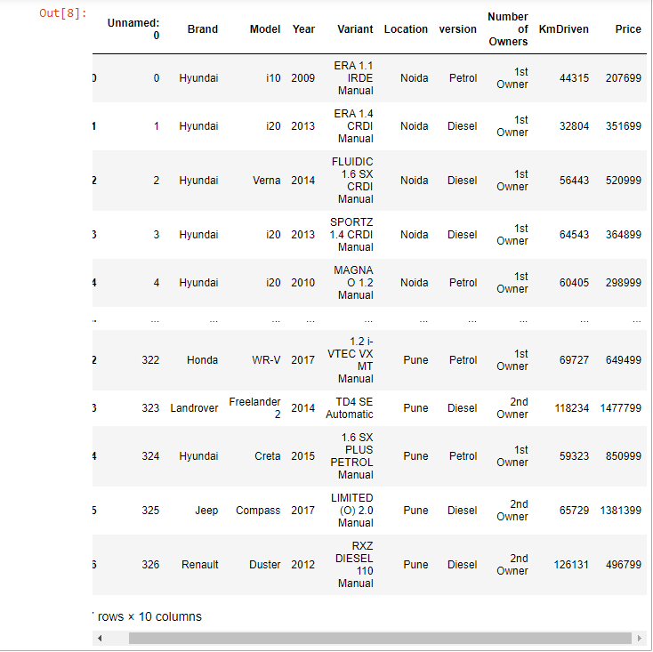
The data types of the dataset are mentioned below:

Slide 9
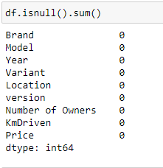
Data Pre-processing checking for the null values in the dataset: after loading the dataset, we checked for the presence of null values or missing values in the dataset. we found that there were no null values in the dataset.

Slide 10
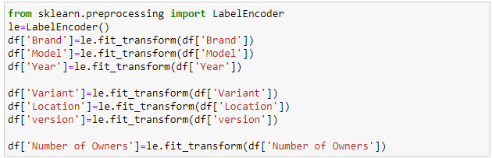
Model/s Development and Evaluation
Label Encoding of categorical columns

Slide 11
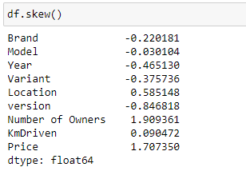
Checking for skewness
Skewness in the dataset:

Slide 12
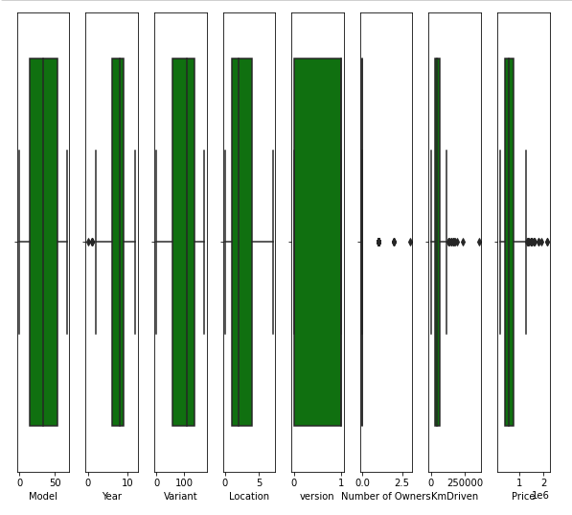
Checking for outliers

Slide 13
Hardware and Software Requirements and Tools Used:

Slide 14
Model/s Development and Evaluation:
Identification of possible problem-solving approaches
(methods).
As we already mentioned above we have continuous target variable so based on the type of variable we are using Regression approach for our model and will use some algorithms like:
Linear Regression
Random Forest Regression

Slide 15
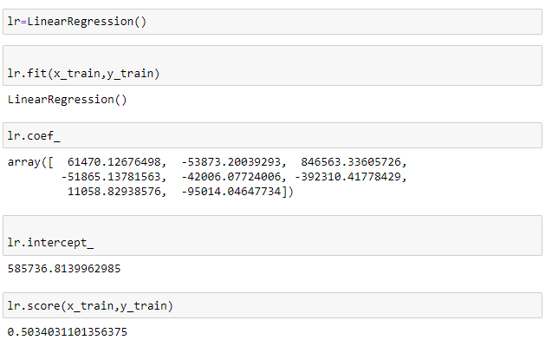
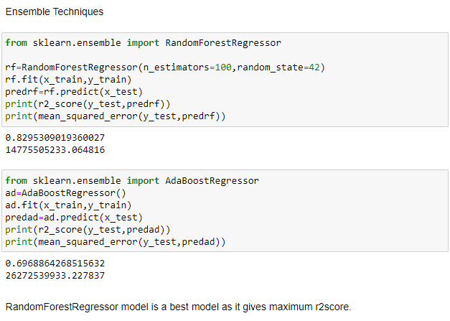
Run and Evaluate selected models:

Slide 16
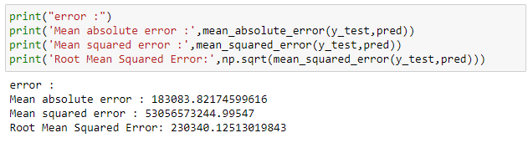
Improvising the model
Key Metrics for success in solving problem under consideration
In this project we have used the following methods to decide the best model:
R2 Score
Mean Absolute Error
Root Mean Squared Error
Cross Validation Score
Standard deviation

Slide 17
Conclusion:
Purchase Year:
Most of the cars which are listed for the re-sale belongs to the year 2010 to 2018. There was less number of cars who was listed from the year 2020, this may be due to the effect of COVID-19 pandemic on the automobile sector.
Owner:
We can say that as the number of owners increases the price of the car decreases. This depends on the purchase year of the car also. If the car is recently purchased then the resale value is more.

Slide 18
Key Findings and Conclusions of the Study:
After working on this project ,we got a lot of insights of how to collect data , pre-process it ,remove unwanted data and how to tackle null values to create a good model. In this project we find various factors responsible for the sale price of a car. Let’s take each variable to describe our observations from this project.
Brand:
After analysing the dataset we draw the outcome that in the Indian market the brands like ‘Maruti’, ‘Hyundai’, ‘Honda’ are covering major portion of the market. If we talk about the valuations of the brands then the premium category brands like Mercedes, Audi, KIA, JEEP are having more value.

Slide 19
Thank you!

